Slide 1


Slide 2
There are many problems are happening around us which are not noticed by proper authority for a proper communication gap between the citizen and respective authority
Solution:
These all can be solved by a proper
communication system
In this whole system one can describe their personal and social problem to the proper authority by connecting directly through this application.
So that people don’t have to search for unauthorized platform.
This application will serve a feedback from the authority to the citizen.
Problem :
Personal harassment
Increasing wastage
Price syndicating
Load Shedding
Emergency Service

Slide 3

Personal harassment
Price Syndicating
It offers a trusted contact whether she can ask for help from and suggests the nearest police station,
“Mark as safe feature” allows a harassed female to send an SMS to the trusted contact to give him a live update whenever the danger has ended.
Map navigation feature guides the girl to the nearest police station
The user can get the real price of product and can complain against syndicating
Load shedding
Access load shedding schedules for multiple suburbs or areas by getting push notification
When the line cut off people can send report and will get confirmation message from the electric board
It will record audio and video for 1m after clicking power button
Increasing wastage
Emergency Service
If the wastage of a certain place isn’t collected by corporation than complaint can be raised by citizen and the citizen can also send photographs of activity Causing pollution and complain would be forwarded to the concerned department
User can make a emergency call and by using gps authority can navigate the location.

Slide 5
Feasibility Study
We are planning to setting up a new communication system that will allow the people to share information and communicate with the proper authorities for solving different types of problem . The system will be very efficient for the society because of its economic feasibility is perfect for the user. The cost for creating the apps will be very low .It's main benefit is that user can easily communicate with the proper channel for solving a problem.The main user of the system is the people which is the operational feasibility.People can easily use the program because it creates a platform which can solve many different types of daily faced problem our life.For solving the real life problems we takes interesting steps such as public harrasment,incresing wastage,loadsheding etc which are reliable for solve the real life problem.

Slide 6
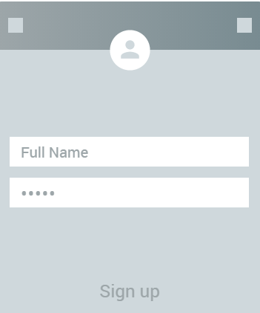
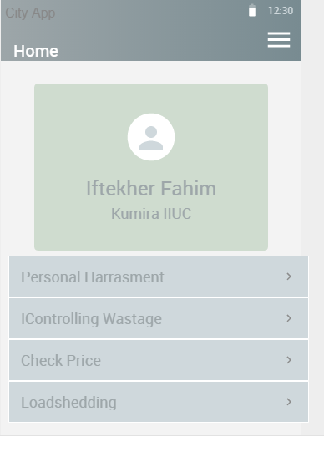
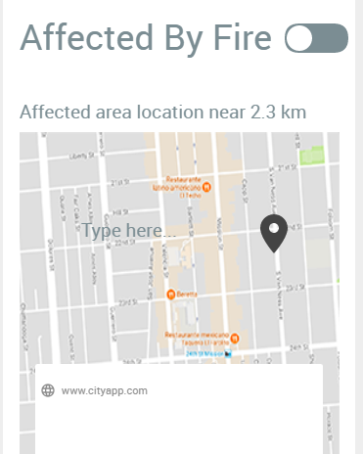
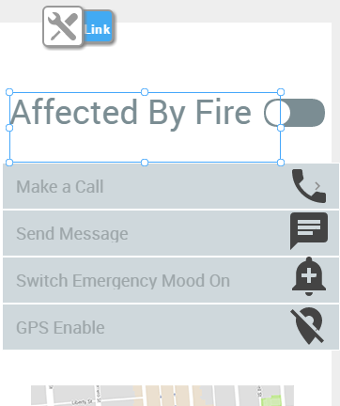
Prototype

